Slide 1

Vehicle Rental
System

Slide 2

INTRODUCTION
Car Rental System (CRS) is a web based system for a company that rents out cars. This system enables the company to make their services available to the public through the internet and also keep records about their services.
The world has become a place where there is a lot of technological development; where every single thing done physically has been transformed into computerized form. Nowadays, people’s activities have been transformed into work done by computerized systems. One of which is the main target of this project which is about Car Rental System. The system of renting cars exist back in the previous years, were people rent cars for their personal reasons. Car renting is essential to many peoples’ plan to travel or move from one place to another for business purposes, tour, and visit or holidays, for these reasons Car renting is very helpful.

Slide 3
Objective
Faster Process – To make sure a user gets his desire car as early as possible; the car rental management system will provide a faster response to complete the process.
Minimize paperwork – As all the system is computerized, there is no need to fill any application form for renting purpose. So, the paperwork will be very less.
Centralized – All types of data and the activities related to the system will be kept in a single place so that it is easy to monitor the system and provide the customer the best service.

Slide 4

Benefits
1. Saves time and cost
2. The rental system provides instant support to the customers
3. The rental system provides easy booking facility for the customers
4. It reduces the usage of paper as all the agreements, invoicing etc. can be done online.

Slide 5
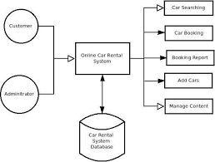
SYSTEM DESIGN

Slide 6

LOGIN PAGE

Slide 7
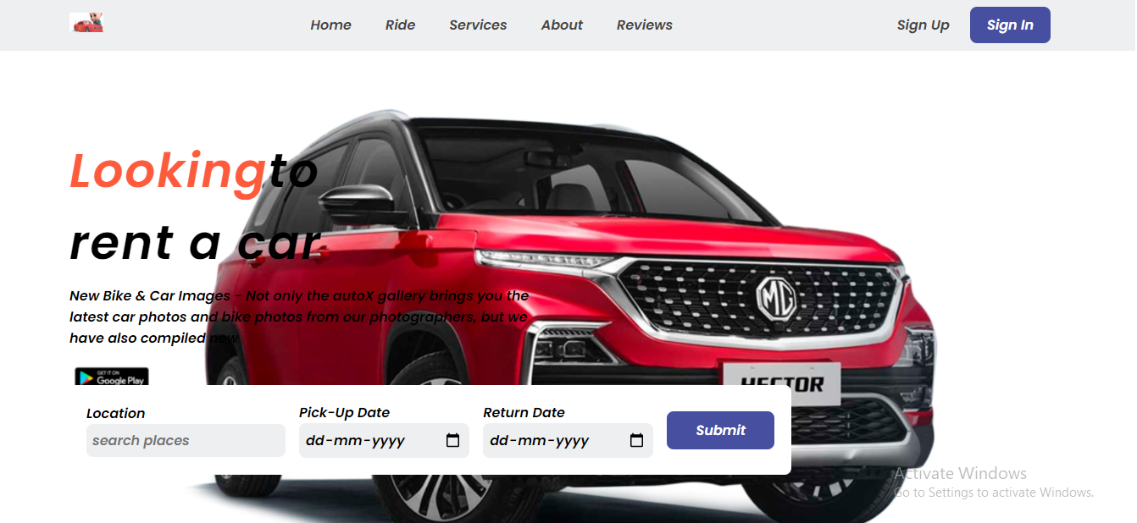
Our Webpage

Slide 8
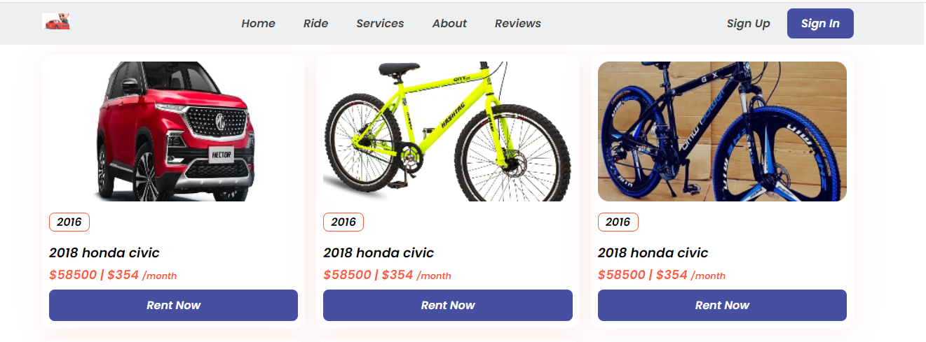
PRODUCT PAGE

Slide 9
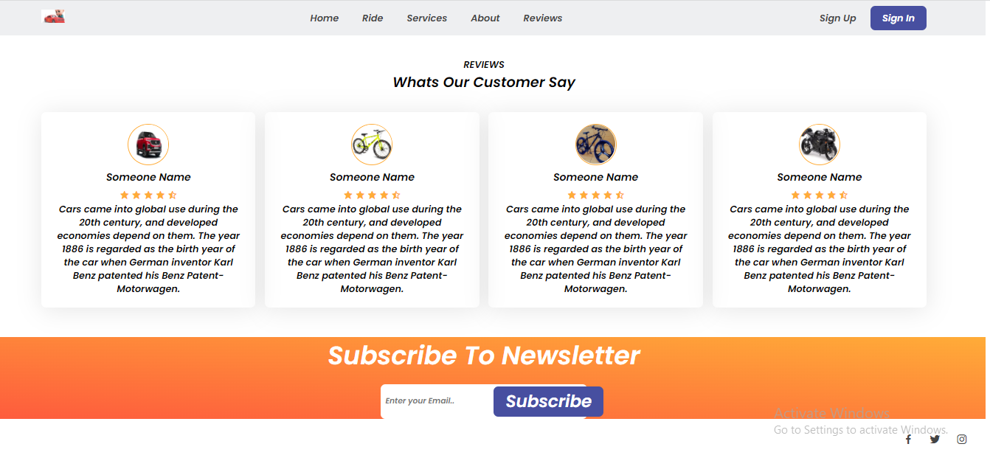
CUSTOMER REVIEW PAGE

Slide 10
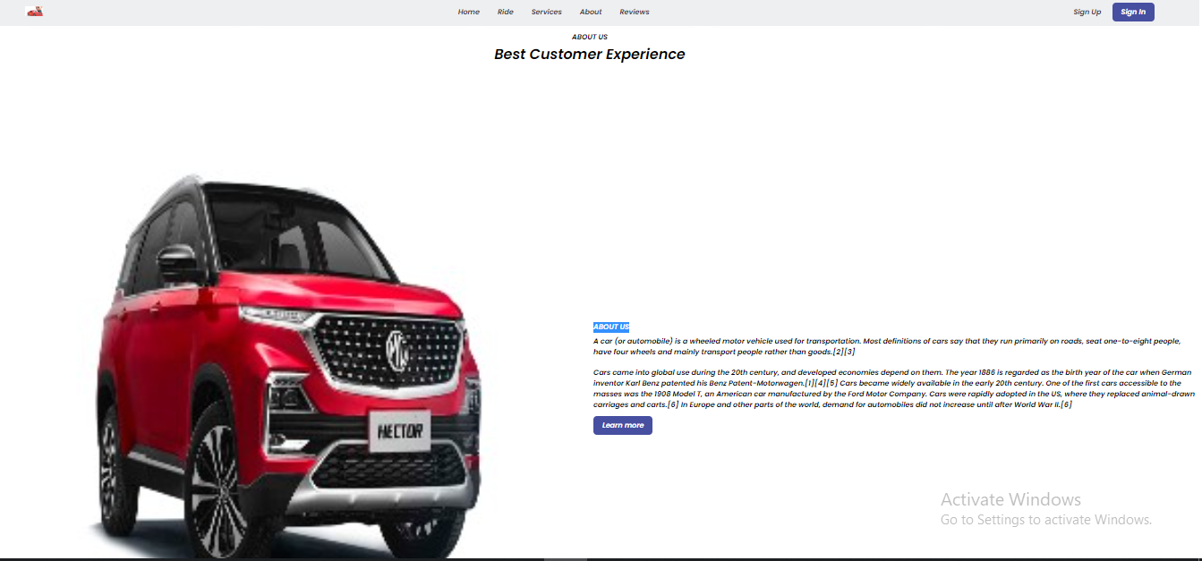
ABOUT US PAGE

Slide 11
Our Philosophy
Mission
Vision
Values
Our mission is to satisfy our customers
and give them what they need.
Our vision is to create a better everyday life for many people.
We value our customers and we will bring change according to the best of interest.

Slide 12
Our Strengths
Loyalty
Efficiency
Reliability
Commitment

Slide 13
TEAM
ABHINAV KUMAR SHARMA
SECTION- N(1) 191500019
CHANDRA PRIY SINGH
SECTION- N(19) 191500225
AYUSH PANDEY
SECTION- O(12) 191500198
GAUTAM SINGH
SECTION- N(26) 191500301

Slide 14
REFERENCES
GOOGLE
W3SCHOOLS
GEEKS FOR GEEKS
ONLINE LEARNING PLATFORMS

Slide 15
THANK YOU!

